Slide 1
Data Driven AI
Week 3 - Lecture 2: Exploratory Data Analysis
Dr. Abirami Gunasekaran
CHS 2406: Data-driven AI

Slide 2
EDA on Breast Cancer dataset
A practical Example

Slide 3
Dataset
The dataset contains patient records from a clinical trial.
Conducted by the German Breast Cancer Study Group (GBSG).
Years: 1984 to 1989.
720 patients diagnosed with Breast cancer.
686 patients' data is complete.

Slide 4
Data Description
The dataset is structured with 11 variables for each patient:
pid: Patient identifier, a unique identifier assigned to each patient in the study.
age: Age of the patient in years.
meno: Menopausal status of the patient. It is represented as 0 for premenopausal and 1 for postmenopausal.
size: Tumor size in millimeters.
grade: Tumor grade, which provides information about the aggressiveness of the tumor.
nodes: Number of positive lymph nodes, indicating the extent of lymph node involvement.
pgr: Progesterone receptors measured in fmol/l (femtomoles per liter).
er: Estrogen receptors measured in fmol/l.
hormon: Hormonal therapy given to the patient. It is represented as 0 for no hormonal therapy and 1 for receiving hormonal therapy.
rfstime: Recurrence-free survival time in days, which refers to the duration until the first occurrence of recurrence, death, or the last follow-up.
status: Patient status indicator, where 0 represents being alive without recurrence, and 1 indicates recurrence or death.

Slide 5
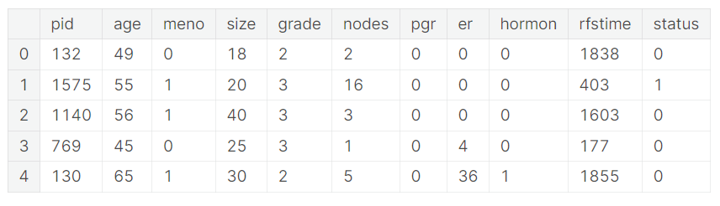

Slide 6
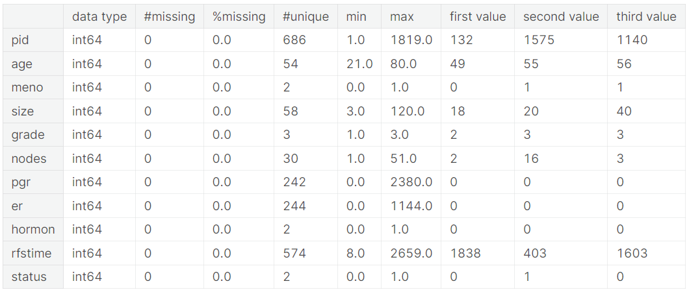
Data Summary

Slide 7
Observations
Observations based on the output of the function:
Data Shape: The DataFrame has 686 rows and 11 columns.
Data Types: The DataFrame contains columns with the following data types:
Integer(11).
Missing Values: There are no missing values in any of the columns since the "#missing" column for each feature has a value of 0.

Slide 8
Observations…
Unique Values: The number of unique values varies for each column. The "#unique" column provides the count of unique values for each feature.
Descriptive Statistics: The summary includes descriptive statistics for each column, including the minimum (min), maximum (max), and the first three values (first value, second value, third value) of each column.
Overall, this summary provides an overview of the DataFrame's shape, data types, missing values, unique values, and descriptive statistics for each column. It can be helpful for understanding the structure and characteristics of the dataset.

Slide 9
EDA
Visualisations

Slide 10
Plotting Functions
Python has several distinct plotting systems
Base python functions
Pie charts
Histogram
Box-plot
Line-graph
Scatter plots
Pair-plots

Slide 11
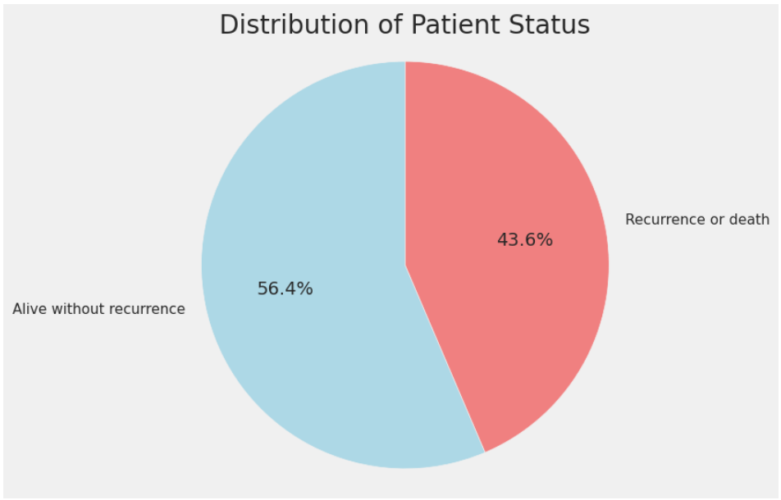
Patient Status - Pie Chart
Categorical Feature (Output variable)

Slide 12
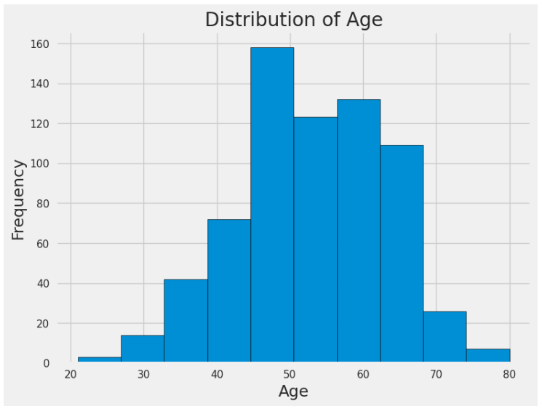
Age Distribution - Histogram Chart
Continuous Feature
Observations
More common in 45-65
Less chances < 35
Useful for awareness campaigns
> Age = > Awareness

Slide 13
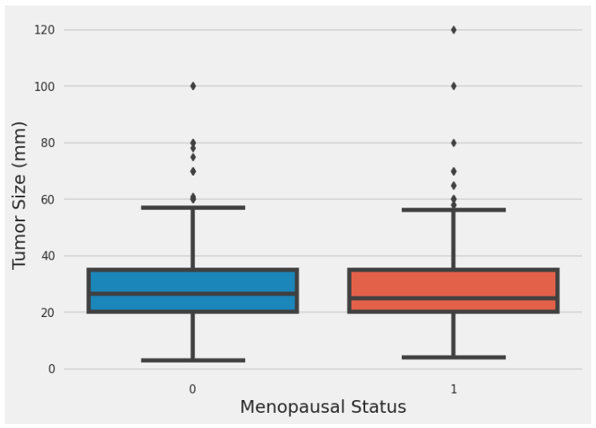
Menopausal Status - Box Chart
Categorical Feature
Observations
Menopausal vs Tumor Size
Same trend for both
More chances of bigger tumor with post menopause
Post menopause is slightly more likely to have bigger tumor size.

Slide 14
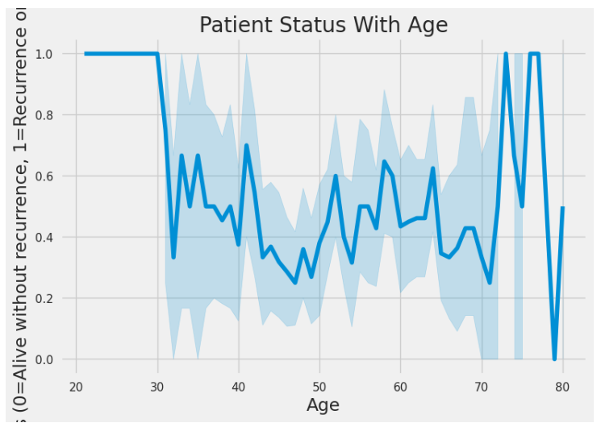
Patient Status With Age - Line Chart
Continuous Feature
Observations
Young girls are most likely to have reoccurrence of tumor!!!
Wrong Data!!!!
Chances of reoccurrence or survival are more for middle-aged women.
More chances of reoccurrence for older women

Slide 15
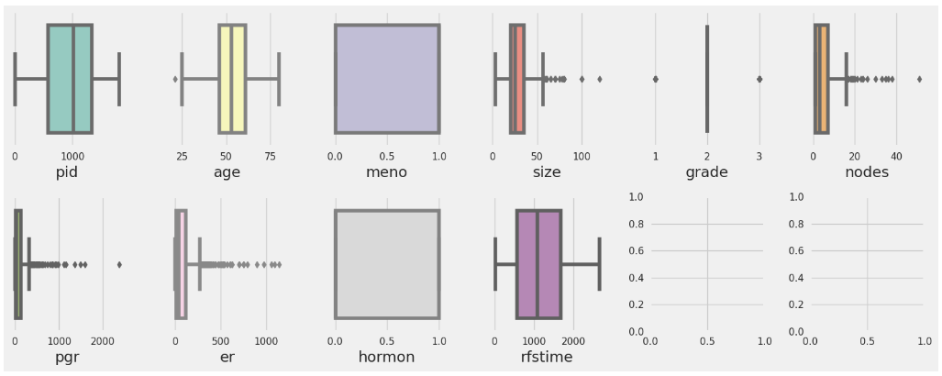
Finding Outliers

Slide 16
Observations
Age has an outlier!
<25 years old rare case!
Could be due to some other medical conditions
Including this rare case could affect our model’s learning

Slide 17
Observations
The tumor size varies between 0 to 55.
Some patients show tumor size >55
This is maybe due to late diagnose
Other medical conditions
Wrong treatment
Age factor

Slide 18
Observations
The number of nodes between 0 to 18.
Some patients have nodes >18
This is maybe due to late diagnose
Body type, Obesity level, lifestyle, ethnicity
Other medical conditions
Age factor

Slide 19
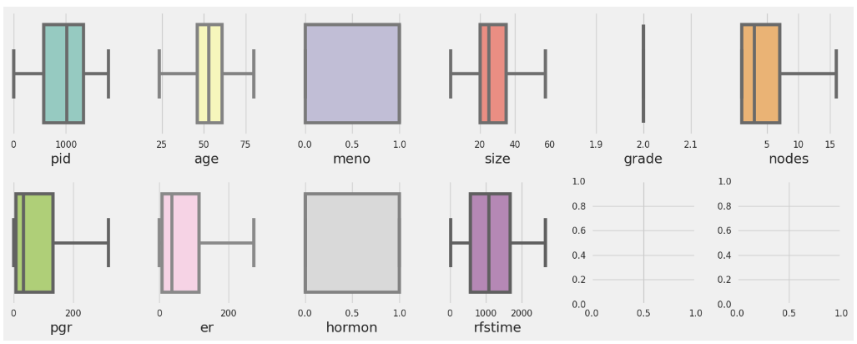
Fixing Outliers

Slide 20
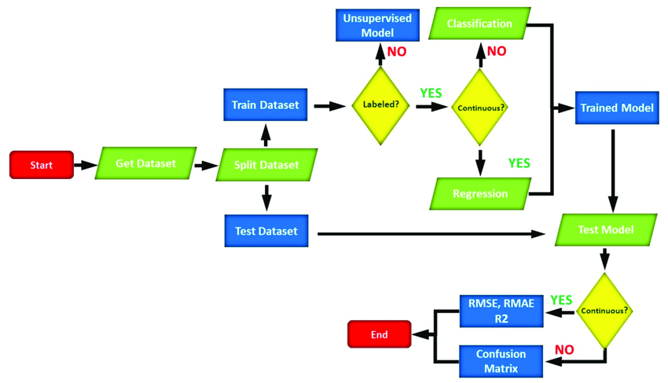
Machine Learning - Workflow
DOI:10.3390/en15072602

Slide 21
Model Training
Logistic Regression
Accuracy: 76%
Precision: 82%
Recall: 68%
F1-Score: 75%
Model Explainability!!!!
Insight into model learning!
What features are more important for our model?
A great source of validating our model’s learning!!!

Slide 22
Feature Importance
Model Explainability

Slide 23
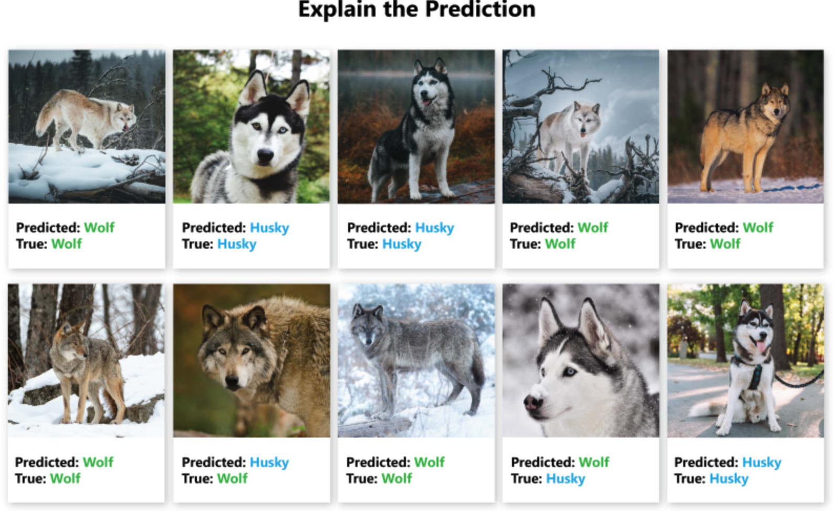
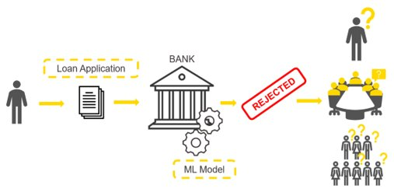
Need for Explainability
Source: www.knime.com
Source: Besse Philippe, et al. (2018)
Notes:
https://www.knime.com/blog/banks-use-xai-transparent-credit-scoring
Besse, Philippe & Castets-Renard, Céline & Garivier, Aurélien & Loubes, Jean-Michel. (2018). Can Everyday AI be Ethical? Machine Learning Algorithm Fairness (english version).
10.13140/RG.2.2.22973.31207.
‘COMPAS Software Results’, Julia Angwin et al. (2016)

Slide 24
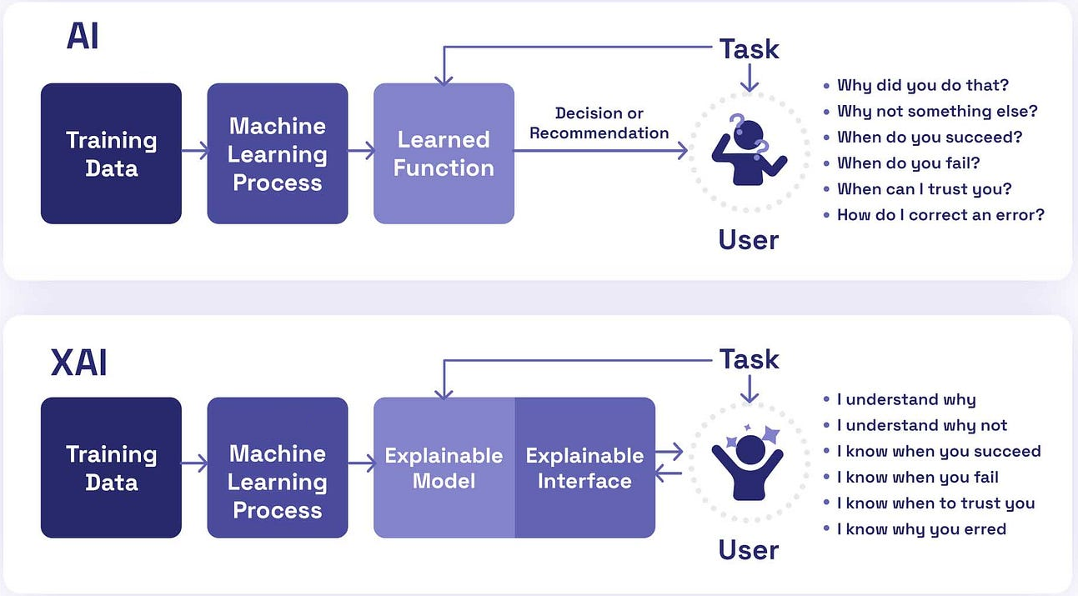
Where the explainability should be applied?
Source: Medium

Slide 25
Python code to get Feature Importance
Tree-based Model (e.g., RandomForest, DecisionTree):
# Get feature importance
feature_importance = pd.DataFrame(
{'Feature': X.columns,
'Importance':model.feature_importances_}
).sort_values(by='Importance', ascending=False)
Print(feature_importance) # can be visualised using bar chart

Slide 26
Python code to get Feature Importance
Other Models (e.g., Logistic Regression, SVM):
# Get feature importance
feature_importance = pd.DataFrame(
{'Feature': X.columns,
'Importance':np.abs(model.coef_[0]) # Coefficients of logistic Regression
}).sort_values(by='Importance', ascending=False)
Print(feature_importance) # can be visualised using bar chart

Slide 27
Using Shap library to get Feature Importance
Tree Models:
# Create a SHAP explainer object
explainer = shap.TreeExplainer(model)
# Calculate SHAP values for the entire dataset
shap_values = explainer.shap_values(X)
# Plot summary plot for feature importance
# Use shap_values[1] for classification tasks to show the SHAP values for class 1 (could also choose other classes).
shap.summary_plot(shap_values[1], X, plot_type="bar")

Slide 28
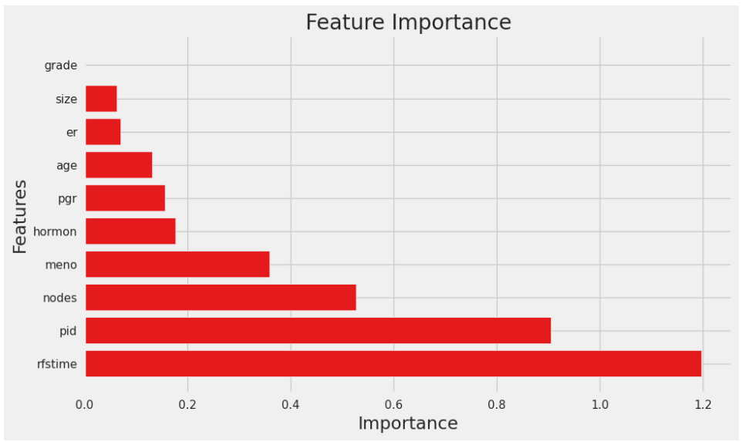
Interpreting Feature Importance values

Slide 29
Left empty intentionally
Any Questions

